Slide 1


PET HEAVEN
WE SUPPORT PET LOVER.
Pet Presentation Template

Slide 2
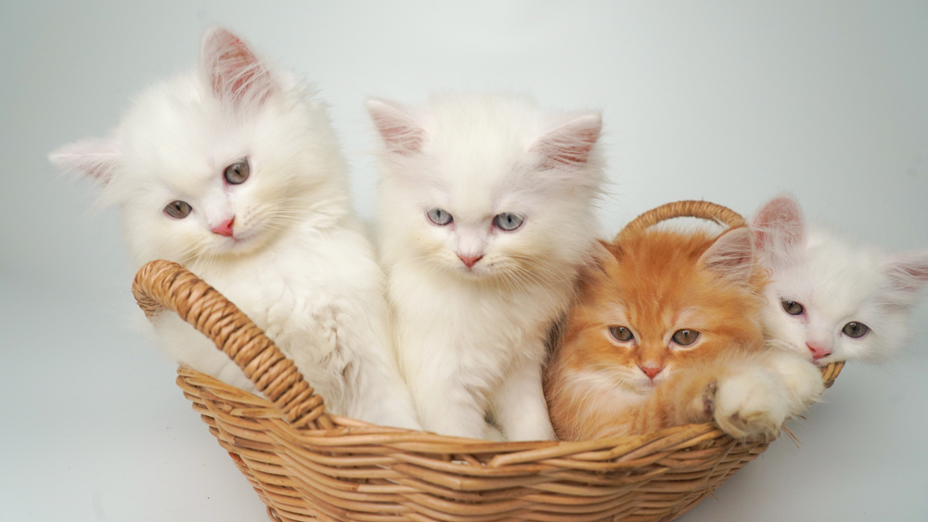
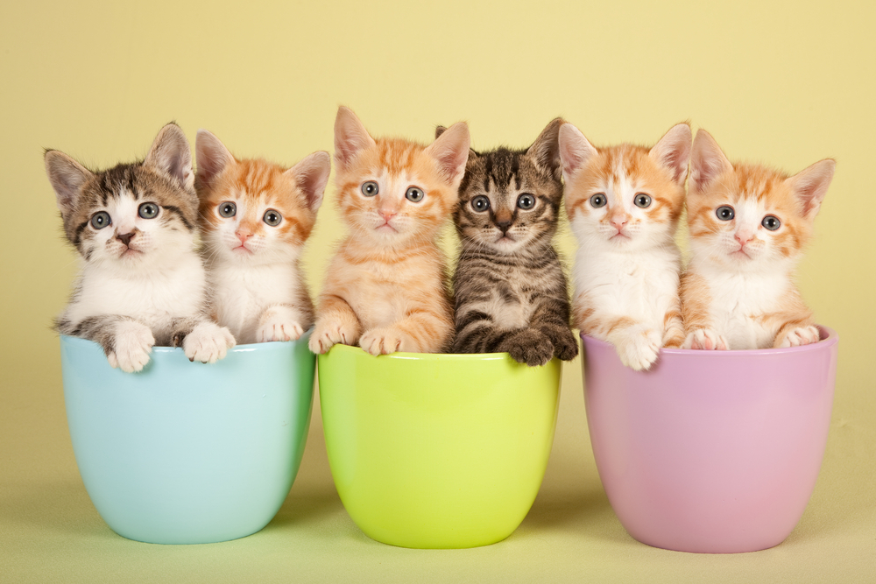
Pet Heaven is a website to operated pet food and supply store. Our mission is to provide dog and cat parents with everything that they need to ensure their pet lives a long and happy life. We love to talk about pets of all types and we are even more excited when you bring your family member into the store to meet us!
ABOUT US

Slide 3
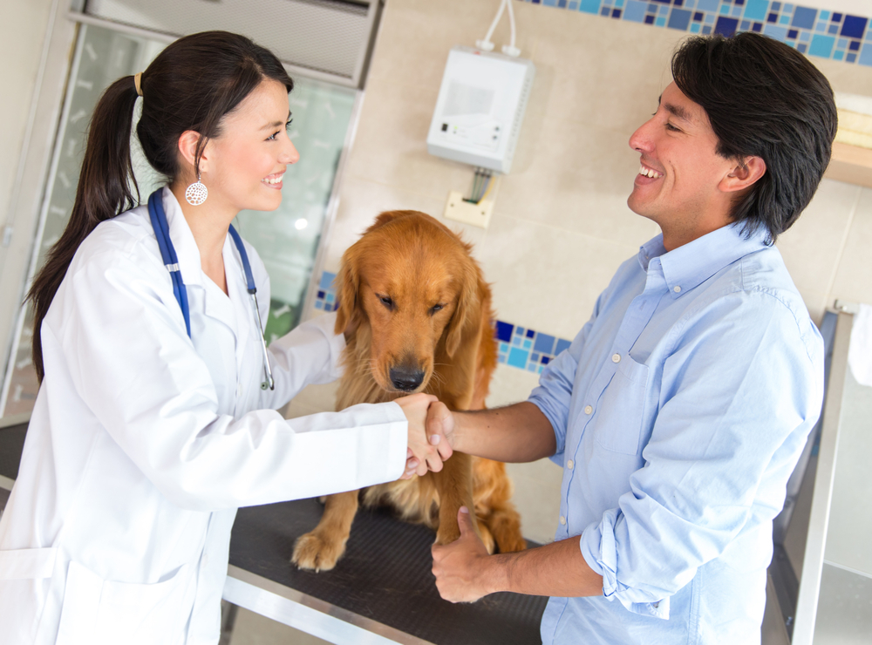
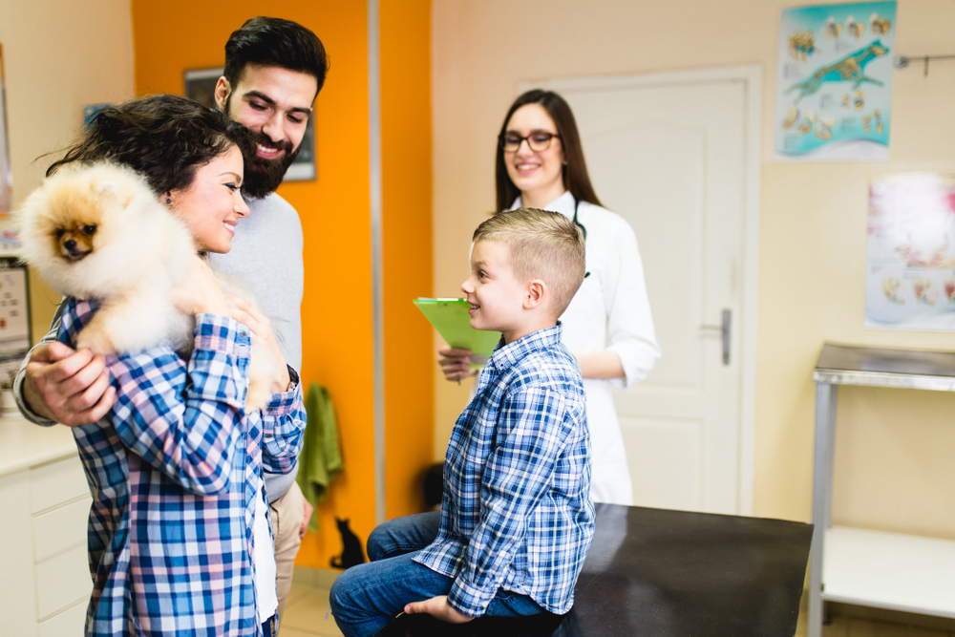
WHY CHOOSE US?
Your Amazing Subheading Here
PROFESSIONAL TEAM
V.I.P SERVICE
Sed ut perspiciatis unde omnis iste natus error sit voluptatem accusantium doloremque laudantium, totam rem aperiam, eaque ipsa quae ab illo inventore veritatis et quasi
Sed ut perspiciatis unde omnis iste natus error sit voluptatem accusantium doloremque laudantium, totam rem aperiam, eaque ipsa quae ab illo inventore veritatis et quasi

Slide 4

VISION ONE
OUR VISION
Sed ut perspiciatis unde omnis iste natus error sit voluptatem accusantium doloremque laudantium, totam rem aperiam, eaque ipsa quae ab illo
VISION TWO
Sed ut perspiciatis unde omnis iste natus error sit voluptatem accusantium doloremque laudantium, totam rem aperiam, eaque ipsa quae ab illo

Slide 5
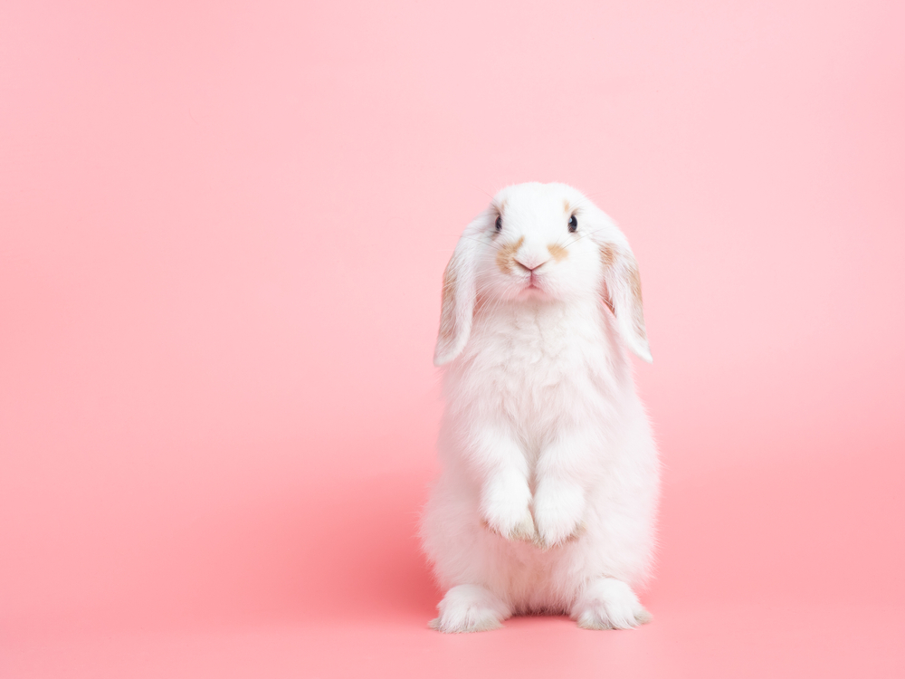
FULL GROOMING
OUR SERVICES
Sed ut perspiciatis unde omnis iste natus error sit voluptatem accusantium doloremque
WE SUPPORT PET LOVER.
PET CARE
Sed ut perspiciatis unde omnis iste natus error sit voluptatem accusantium doloremque
vaccination
Sed ut perspiciatis unde omnis iste natus error sit voluptatem accusantium doloremque
Sed ut perspiciatis unde omnis iste natus error sit voluptatem accusantium doloremque
BOARDING

Slide 6
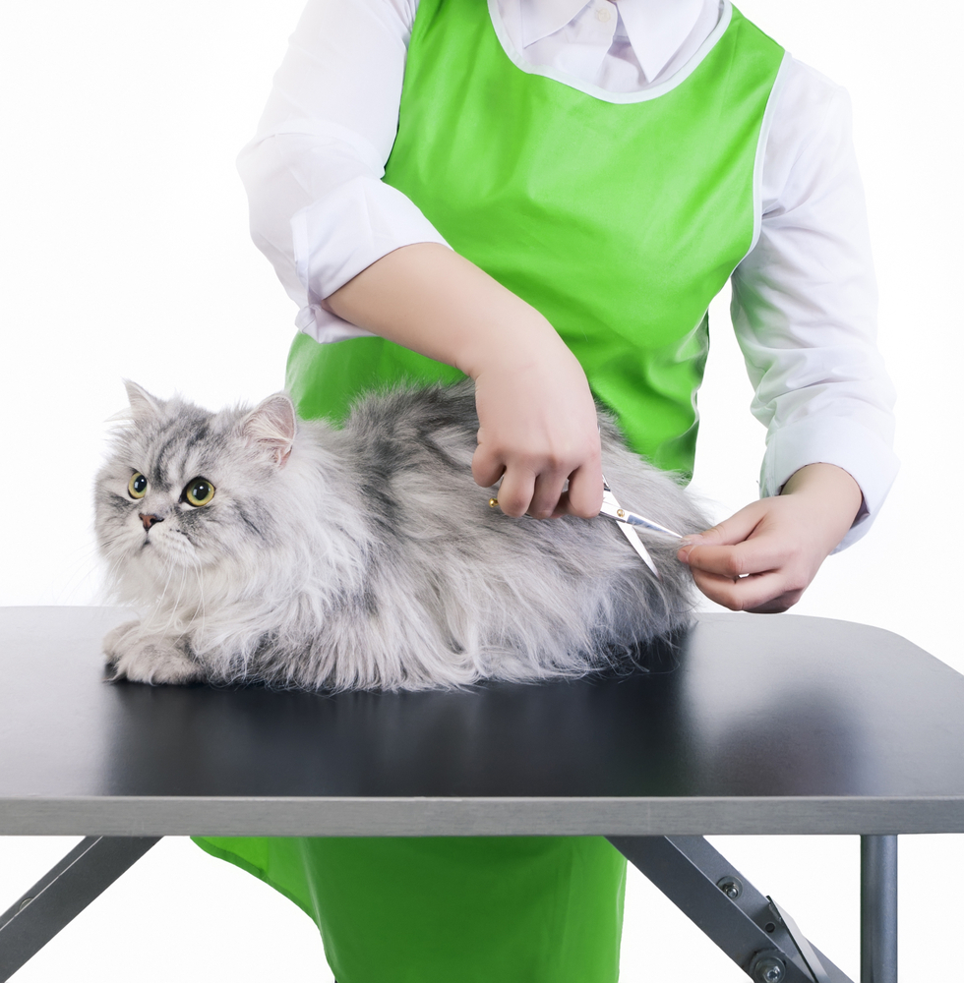
FULL GROOMING
Bringing out the best in pets.
We provide Bathing, conditioning, and drying pets. Trimming pets' nails, brushing their teeth, and cleaning their ears. Grooming and styling pets according to pet owners' instructions or standard grooming styles.

Slide 7
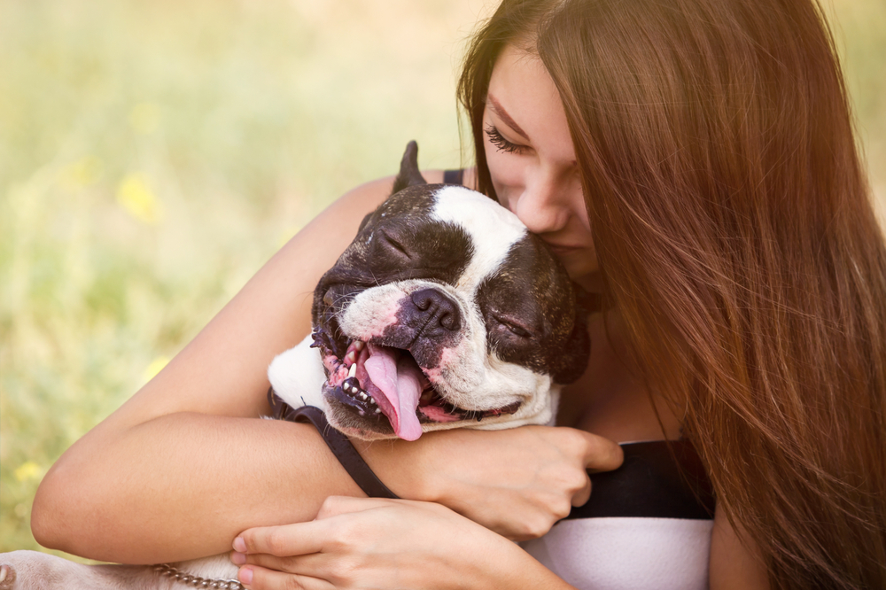
PET CARE
Taking care of your pet in the most efficient way.
care is the most typical type of pet sitting service. While a pet owner is on vacation, a pet sitter will arrange to visit the client's home for a period of time and frequency as determined between the pet owner and sitter.

Slide 8
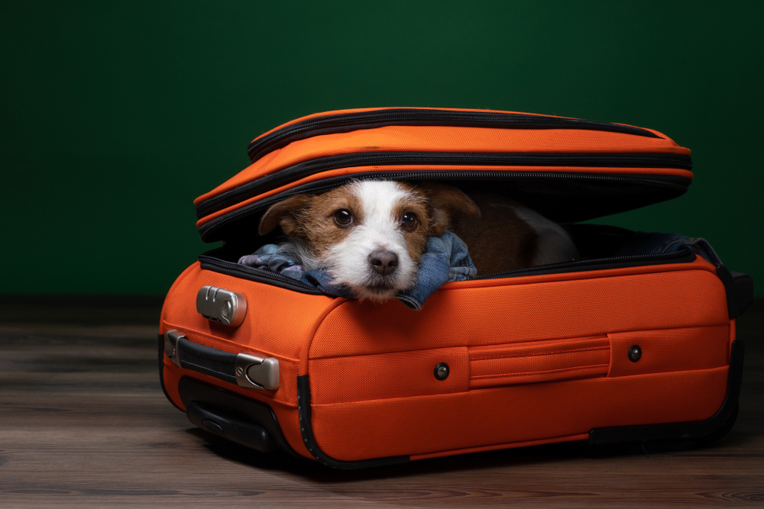
Pet sitters provide daily care for pets while their owners are on vacation. They typically stay in the home of the owner, so the pets can remain on their familiar territory. In addition to caring for pets, they may also provide basic services for the owner, such as collecting mail and vacuuming pet hair.
You'll love coming home to a happy dog!
Purrr-fect pet care for all your feline friends.
Pets are happy when you leave them with us.
BOARDING
Your pets are in good paws with us.

Slide 9
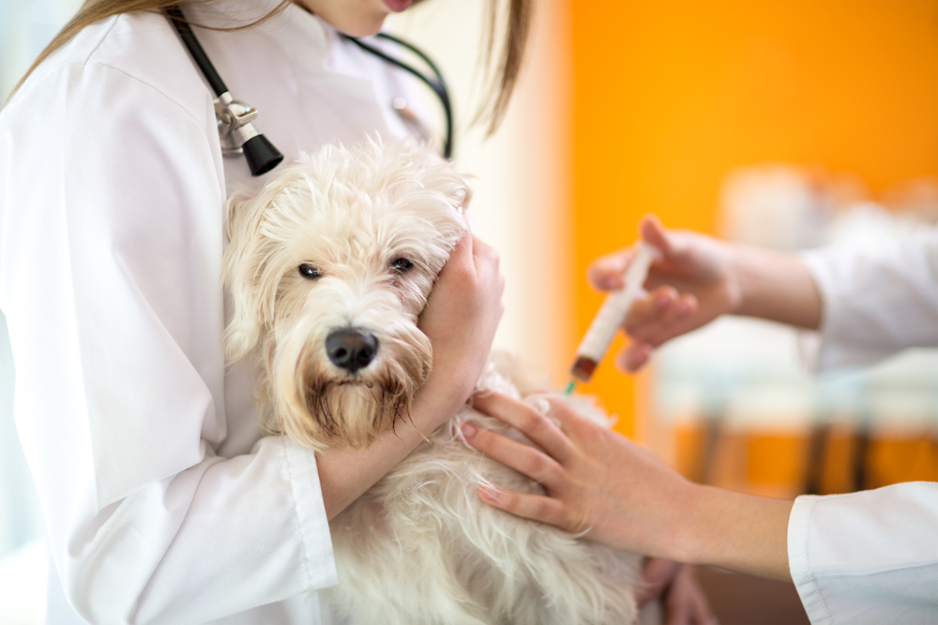
VACCINATION
love pets almost as much as we love our kids.
Core vaccines are considered vital to all pets based on risk of exposure, severity of disease or transmissibility to humans. Vaccines for canine parvovirus, distemper, canine hepatitis and rabies are considered core vaccines. Non-core vaccines are given depending on the dog's exposure risk.
Caring Your pet Better
Passionate about pets.
Love them Enough, Give them the Best

Slide 10
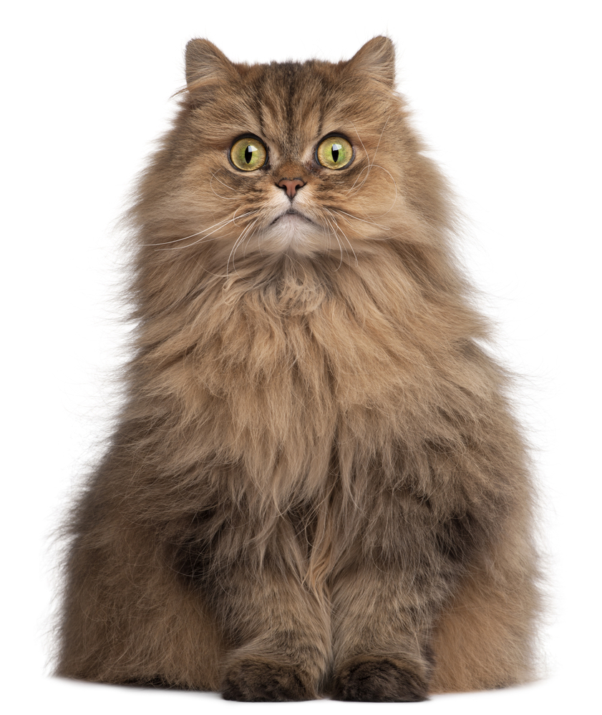
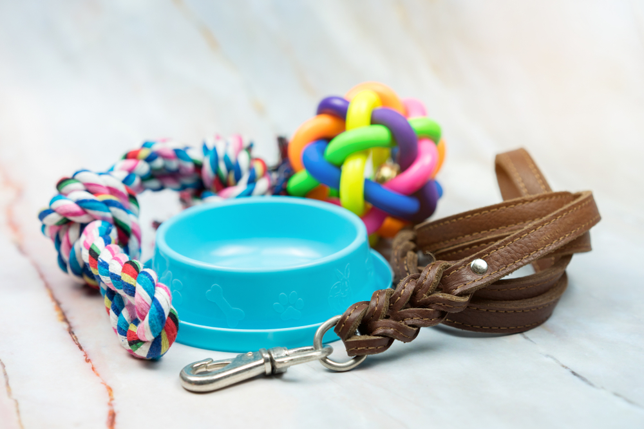

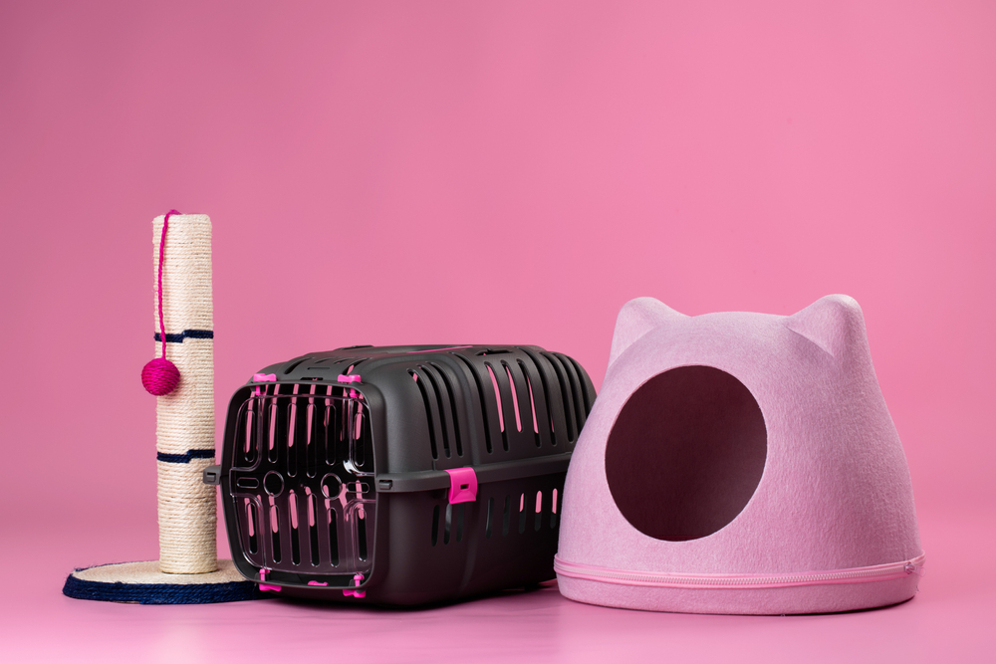
SHOP
PUG DOG
250$
Brush and
rubber toy.
AMERICAN
DOG COLLAR
MIDDLE DOG LEAD
PERSIAN
Pink pastel
Bowl, rope,
rubber toys
350$
100$

Slide 11
PET BLOG
making your Pet Happier
Sed ut perspiciatis unde omnis iste natus error sit voluptatem accusantium doloremque laudantium, totam rem aperiam, eaque ipsa quae ab illo inventore veritatis et quasi
Best Toys for Best Pets
The joy of the best Things
Pet deserves more Care

Slide 12
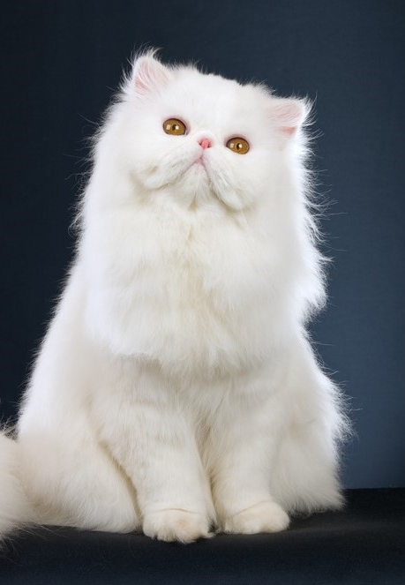
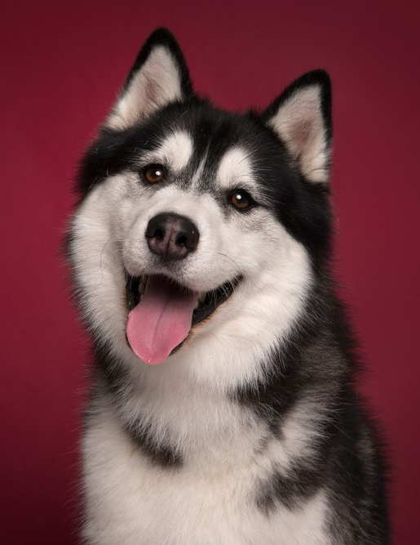
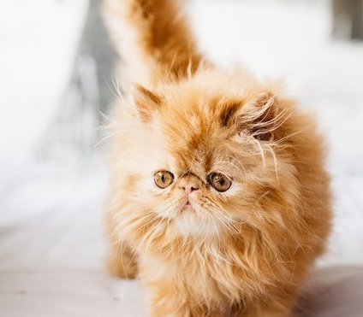
OUR GALLERY
Sed ut perspiciatis unde omnis iste natus error sit voluptatem accusantium doloremque laudantium, totam rem
Your Amazing Subheading Here

Slide 13
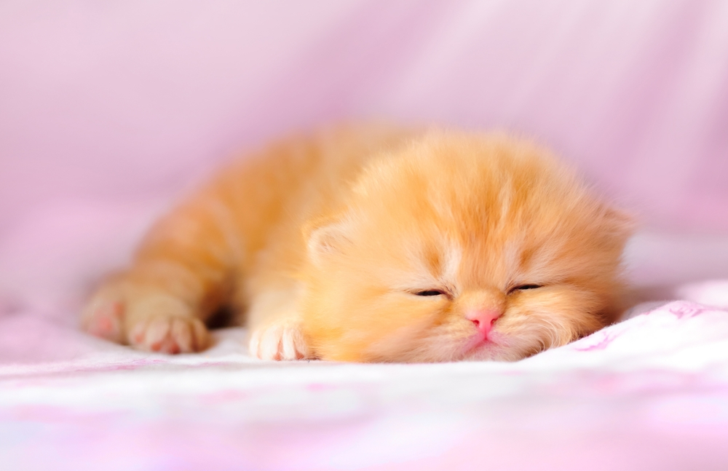
THANKS

